Slide 1
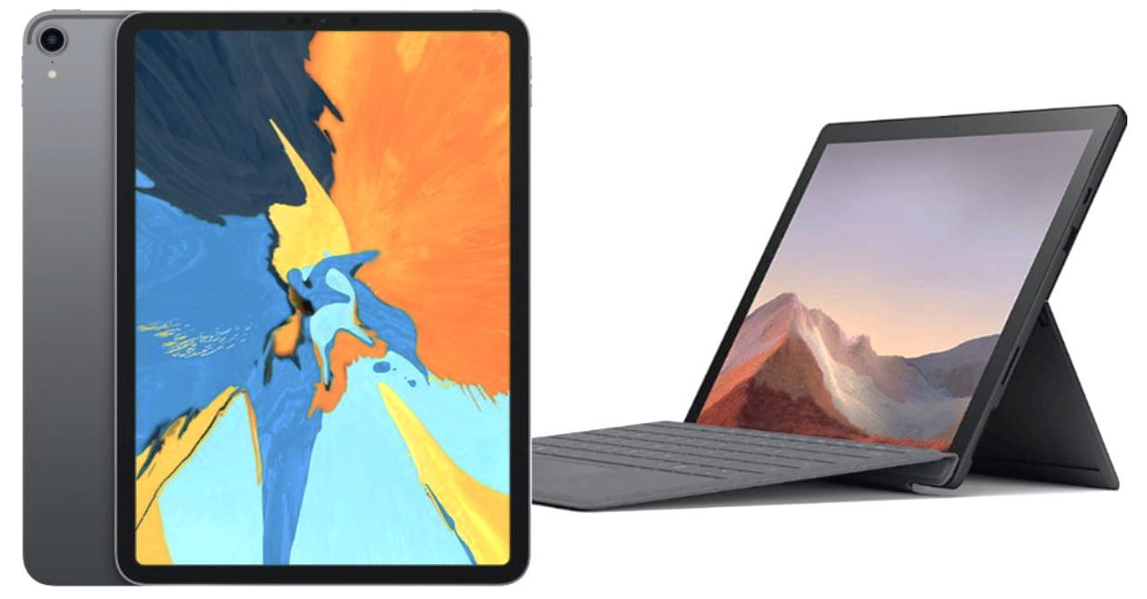
Microsoft Surface & Apple iPad
Commercial Airings Analysis
Ling Jiang

Slide 2
Agenda
Overview
Dataset Introduction
Dataset Review
Analysis
Summary

Slide 3
Overview
Microsoft Surface and Apple iPad are two of the most popular touchscreen-based personal computers and interactive whiteboards designed and developed by Microsoft and Apple Inc. respectively. We are trying to generally differentiate these two products in the following ways based on their commercial airings data.
Target customers
Product features

Slide 4
Dataset Introduction
Commercial Airing Data of two products from October 2019 to December 2019
Dataset includes: Id, Title, Brand, Product, Category, Network, Network Type, Show, Date, Time, Pod Position, Dayparts, Duration, EQ Units, Spend($), Broadcast Year, Broadcast Month, Broadcast Week, Day of Week, Hour of Day, Time Zone
Microsoft Surface commercial lasts 30 seconds, while Apple iPad commercial lasts 60 seconds
Data Source:
Microsoft Surface: https://insights.alphonso.tv/commercial/3952688-Microsoft-Surface?et=2020-01-23&n=a&st=2019-10-01
Apple iPad: https://insights.alphonso.tv/commercial/4013130-Apple-iPad-%22Make-Someone's-Holiday%22?et=2020-01-23&n=a&st=2019-10-01

Slide 5
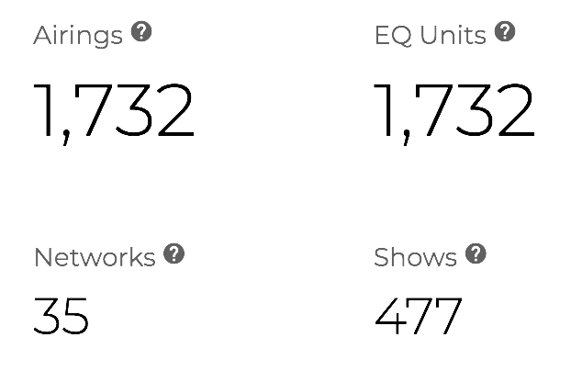
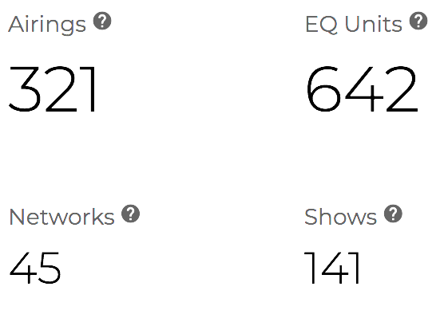
Dataset Review
Microsoft Surface
Apple iPad
During the same campaign period, the investment of Microsoft doubled that of Apple.
Microsoft commercials aired much more but used less Networks compared to Apple.
Total Cost 23.5M
Total Cost 12.2M
* Airings is the number of times a commercial airs on TV.
* EQ Units is the number obtained by converting the airings of a commercial into EQ units.
* Networks is the number of unique networks a commercial airs on.
* Shows is the number of shows a commercial airs on.

Slide 6
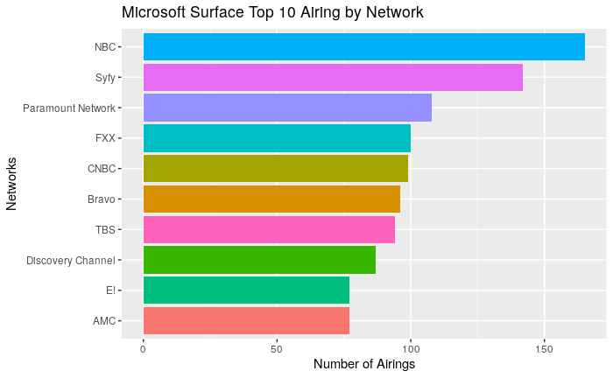
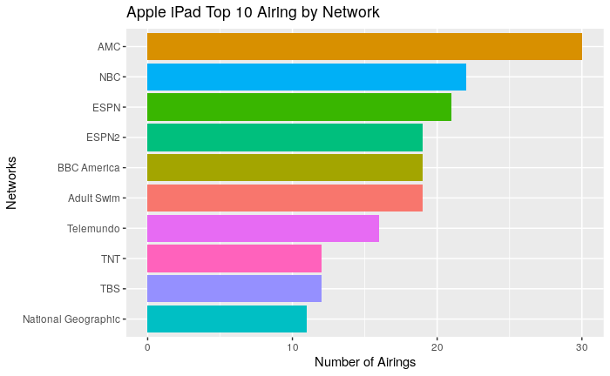
Top 10 Airings by Network - Cable & Broadcast
Airing network has two types, Cable and Broadcast. Broadcast is the most common and available to any TVs, while Cable is more private and demand-driven.
Generally, both of companies air more on NBC, TBS and AMC.

Slide 7
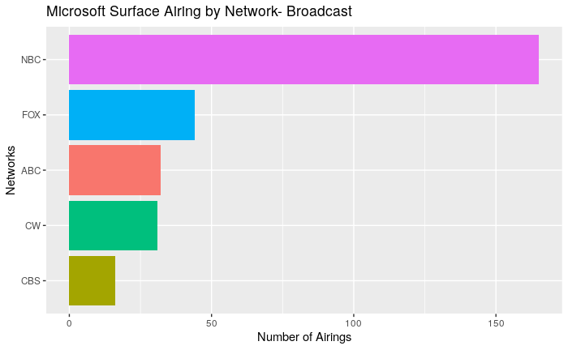
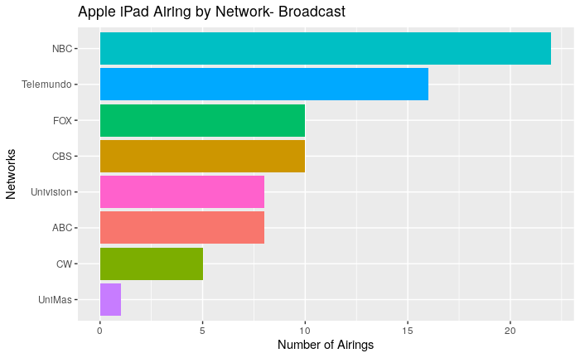
Airings by Broadcast
Compared to Microsoft Surface, Apple iPad has 3 more Spanish-language broadcast networks, indicating that Apple also target Spanish-speaking customers, and has a wider range of target market .

Slide 8
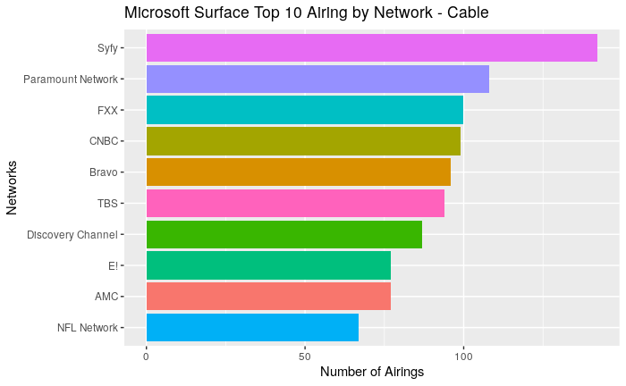
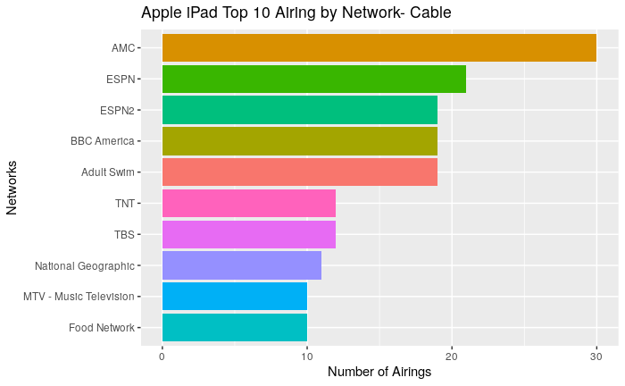
Top 10 Airings by Cable
For Cable Networks, Microsoft Surface airs most on Syfy, Paramount Network and FXX, while Apple iPad airs most on AMC, ESPN and BBC America.
Microsoft Surface focuses more on TV shows, while Apple iPad pays more attention to sport events, news and movies.

Slide 9
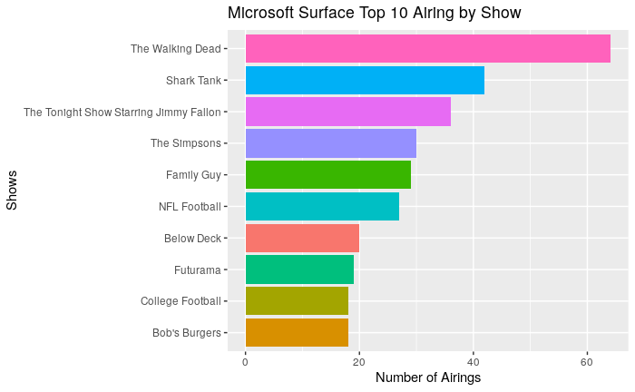
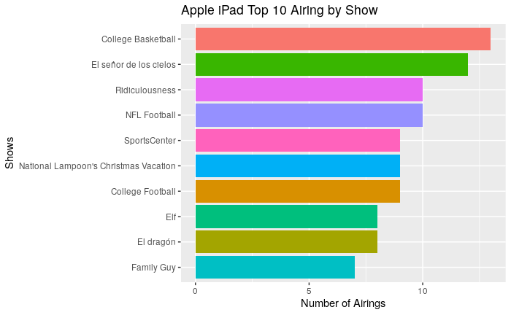
Top 10 Airings by Shows
More specifically, Microsoft iPad airs more on TV shows, especially popular TV shows, in order to expand the awareness of the product.
Apple iPad airs more on sport events, especially college sport events, indicating that it focuses more on young people, and builds a vigorous product image.

Slide 10
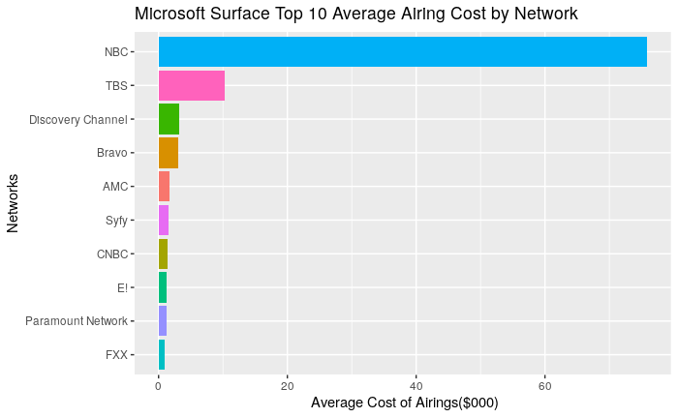
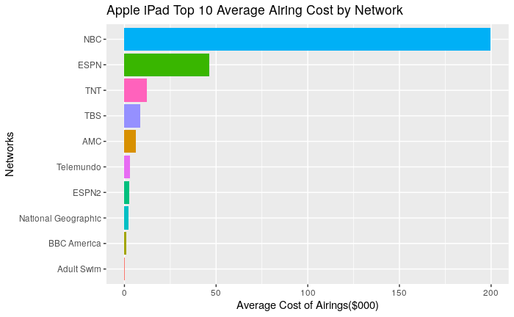
Cost by Networks
NBC is the most expensive network for both products.
Apple iPad has higher airing price, even though it invests less networks than Microsoft Surface.

Slide 11
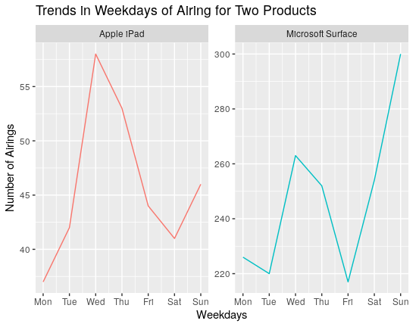
Trends in Weekdays
Apple iPad commercial airs most on Wednesday.
Microsoft Surface commercial airs most on Sunday/
Microsoft Surface targets those with working ages more.

Slide 12
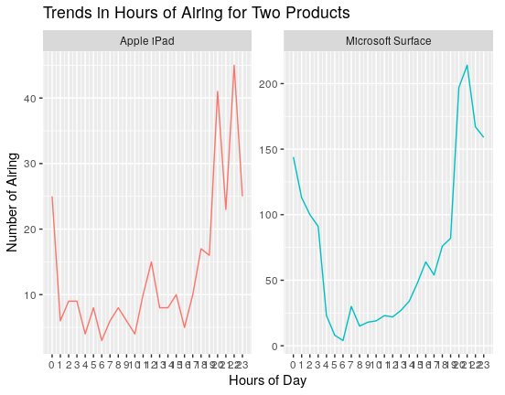
Trends in Hours
The number of airs increases from 17 and reaches the peak at 22.
Apple iPad commercial has two airing peaks at night (at 20 and 22).
Microsoft Surface reaches the peak at 21.

Slide 13
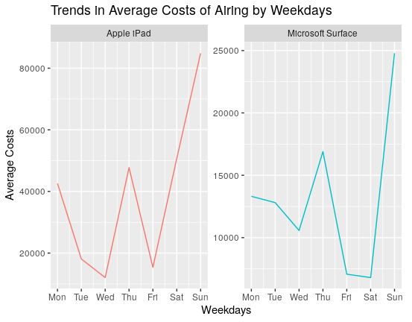
Trends in Cost by Weekdays
Two products have same costs trends by weekdays.

Slide 14
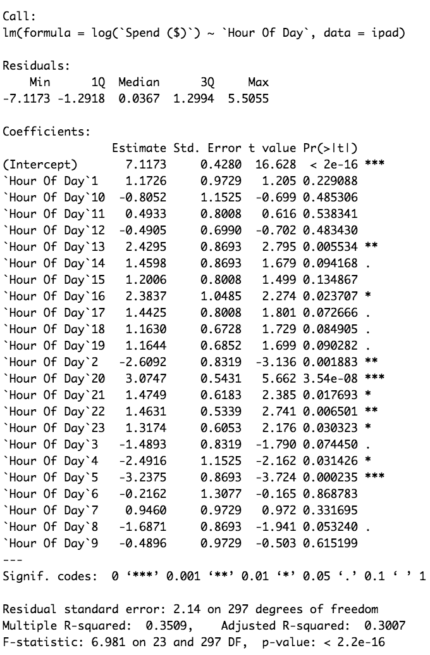
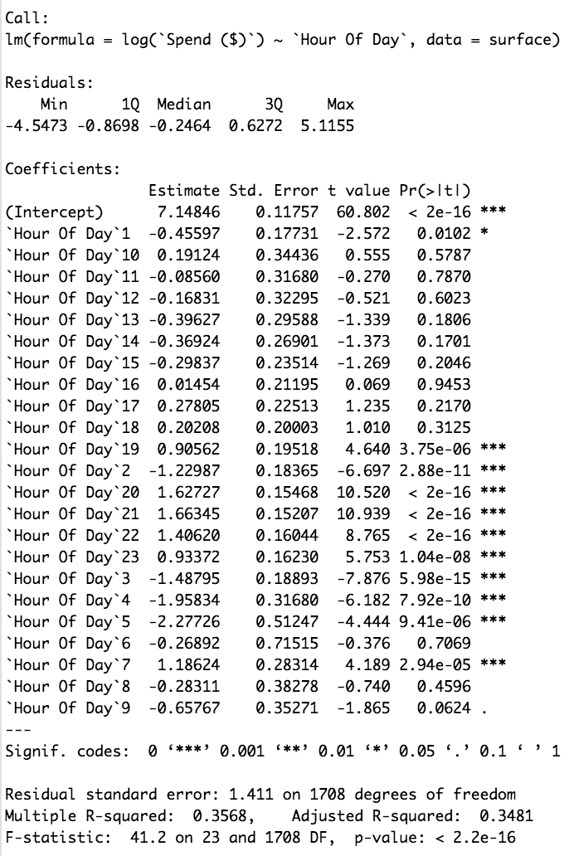
Regression Models
Apple iPad
Microsoft Surface
Using Linear Regression models to find statistical relationship between the cost of airing commercials and other variables. Since the limitation of dataset, simple linear regression with fewer variables can only be used.
The R-square from the both of the relative best model is about 0.35 with the variable Hour of Day.
The Best Simple Linear Regression:
ln(log(spend)~ + factor(`Hour Of Day`))

Slide 15
Summary
Microsoft Surface highlights creativity and productivity; Apple iPad highlights entertainment and vigorous product images.
Microsoft Surface targets young people, especially those with working ages; Apple iPad targets mostly college students.
Please refer to the R code for this case:
https://github.com/lingjiangj/Commercial-Airings-Analysis-for-Alphonso-Job-Application/blob/master/data%20analysis.Rmd

Slide 16
Thank you.

